Slide 2
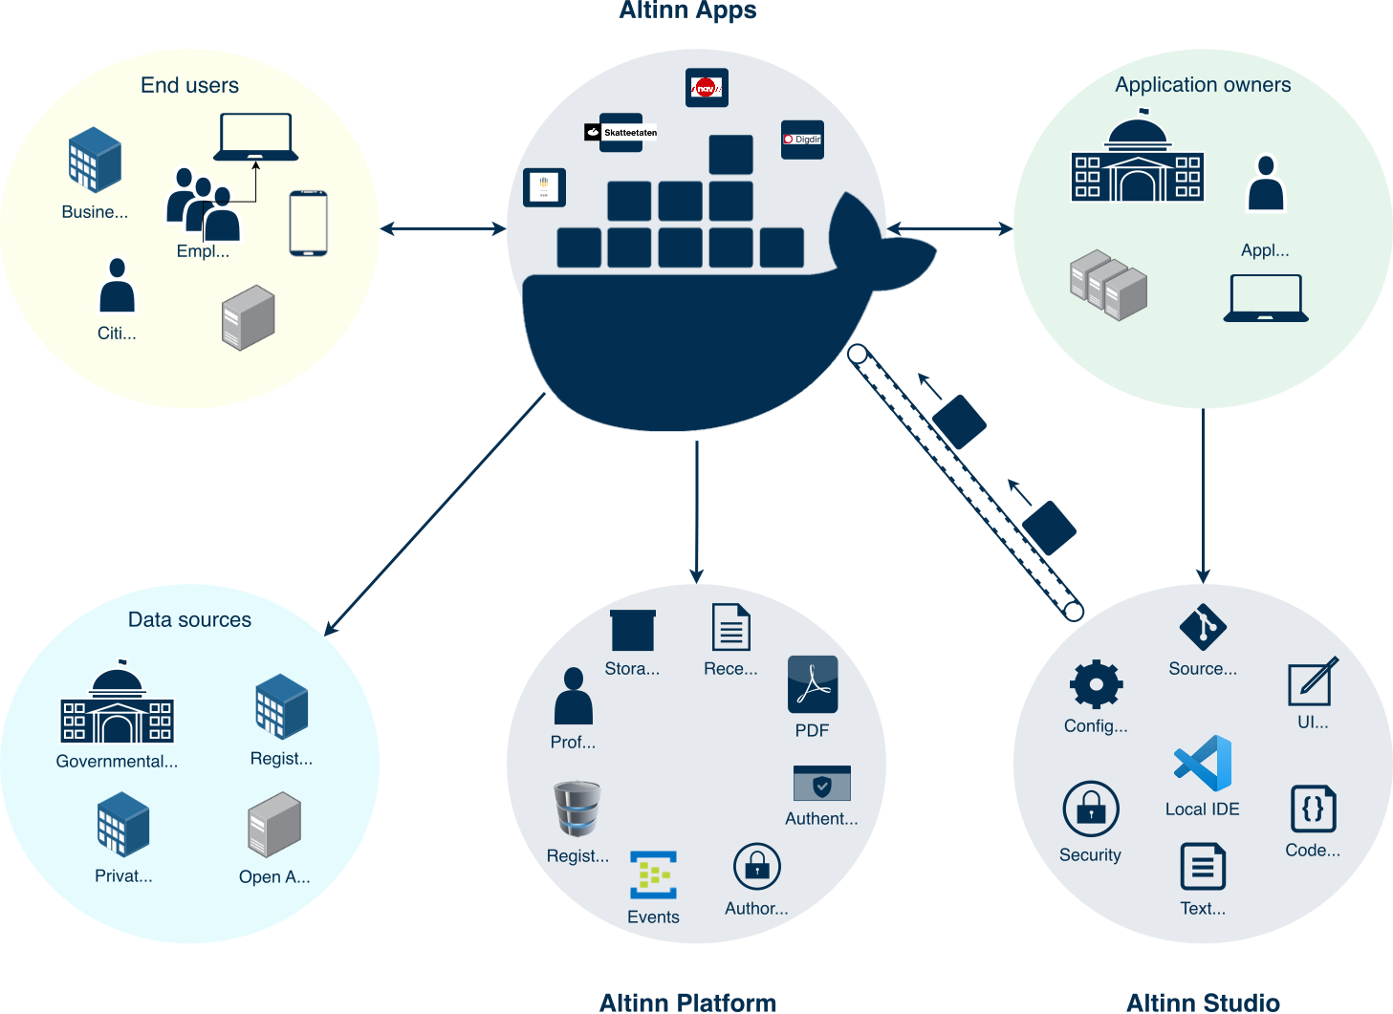
https://docs.altinn.studio/teknologi/altinnstudio/about/concept3.svg

Slide 3
https://docs.altinn.studio/teknologi/altinnstudio/about/concept3.svg

Slide 4



Kubernetes
Application Insights
Key Vault
Applications
Traces and logs
Secrets

Slide 5
Send logs
Fetch secrets

Slide 6

Appscluster
Developer
Operations

Slide 7

Appscluster
Developer
Operations

Slide 8

Appscluster
Developer
Operations

Slide 9
Appscluster
Developer
Operations

Slide 10
Demo

Slide 11
https://altinn.github.io/docs/altinn-studio/getting-started/access-management/apps/

